Slide 1
The Pure Exchange Model
Steven Suranovic
George Washington University

Slide 2
Pure Exchange Model Assumptions
There are two people (Smith(S) and Jones(J))
There are two homogeneous goods (apples(A) and oranges(O))
Smith and Jones receive utility (happiness) from consuming apples and oranges.
Smith and Jones know their preferences for oranges and apples → they know how much utility they get from any possible bundle of oranges and apples consumed (#O, #A)

Slide 3
Pure Exchange Model Assumptions
Smith’s and Jones’s preferences have two characteristics
more goods are better than fewer goods.
Diminishing marginal utility in consumption of both goods
Smith is endowed with 10 oranges
Jones is endowed with 10 apples

Slide 4
Pure Exchange Model Assumptions
Suppose Smith receives utility in consuming apples according to the schedule on the right.
More is better is true because as apples rises, utils rise (0,20,38,54 …)
Marginal utility is diminishing because it falls with greater apples (20,18,16…)
# of apples | Utils of happiness | Marginal Utility (utils)
0 | 0
1 | 20 | 20
2 | 38 | 18
3 | 54 | 16
4 | 68 | 14

Slide 5
Pure Exchange Model Assumptions
Smith and Jones seek higher utility – they want to be happier
Smith and Jones are self-interested only
soon we’ll assume Smith and Jones “maximize utility”
Smith and Jones are willing to engage in mutually voluntary trade
Smith and Jones know perfectly the quality of the other’s goods

Slide 6
Implicit Model Assumptions
Smith and Jones are humans (Nobody ever saw a dog …. )
Smith and Jones can meet with each other in the same location (call this location a market)
Smith and Jones can communicate with each other – they share the same language.

Slide 7
Indifference Curve Construction
10
8
U = 6
U = 9
Apples (#)
U = 8
6
U = 5
4
U = 6
U = 5
2
U = 3
0
Smith
0
2
4
6
8
10
Oranges (#)

Slide 8
Indifference Curve Construction
Each point on the diagram is a bundle of goods and has a utility (happiness) value.
Smith knowing his preferences means he knows how much utility (or happiness, or satisfaction) he gets from each bundle
If Smith cannot measure his utility (bec. utility is actually immeasurable), he can at least rank two bundles as more, less, or equally preferred to each other.

Slide 9
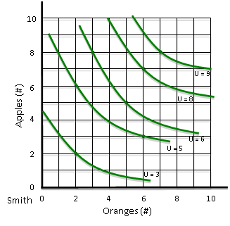
Indifference Curve Construction

Slide 10
Indifference Curve Use
An Indifference Curves (IC) that is upward/rightward of another gives higher utility
Because more is better
Indifference curves will curve towards the origin (0,0)
Because of diminishing marginal utility
What if marginal utility is constant? … or increasing?

Slide 11
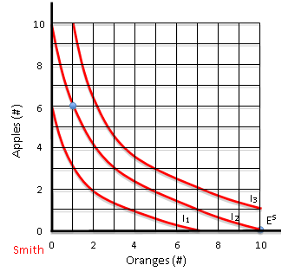
Smith’s Preferences and Endowment

Slide 12
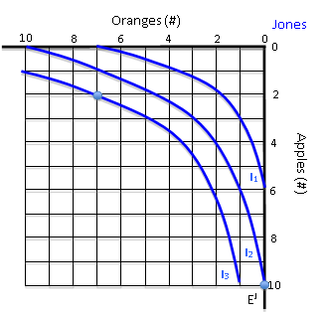
Jones’ Preferences and Endowment

Slide 13
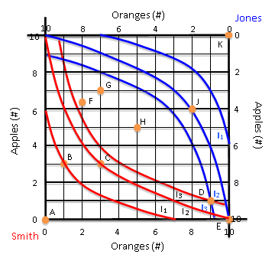
Construction of an Edgeworth Box
Superimpose the endowment of right-side-up Smith with the endowment of upside-down Jones
The EB has dimensions given by the total number of oranges and apples between the two combined.
Every point in the EB represents an allocation of oranges and apples between the two.

Slide 14
Construction of an Edgeworth Box
If Smith has 10 oranges and Jones 10 apples
Then the endowment is at point E
How many oranges and apples would Smith (Jones) have at … ?
Point G
Point J
Point A

Slide 15
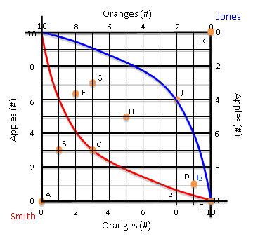
Construction of an Edgeworth Box
Any diagonal movement from the endowment E, represents trade, or exchange.
For example, to move from E to D, Smith exchanges one orange for one apple with Jones.
This exchange makes both better-off
Both reach a higher IC
Due to DMU, both give up a lower value item for a higher value item.

Slide 18
Implications of the Edgeworth Box Model
Trade (or exchange of oranges for apples) between Smith and Jones that results in a bundle within the lens (formed by Smith and Jones’ ICs passing thru the endowment point in an Edgeworth box) will raise utility for both. (Eg. Pts H, G, F)
Trade to F, G or H is mutually beneficial
Trade will occur because we assume they both want to raise their utility

Slide 19
Implications of the Edgeworth Box Model
If the assumptions of the model hold, especially,
If Smith and Jones have perfect information
They know their preferences and they know the goods quality
And, if they trade mutually voluntarily
Then, BOTH are better-off than before trade. Both are happier.
Trade is WIN – WIN,
not WIN - LOSE

Slide 20
Implications of the Edgeworth Box Model
The EB displays human’s propensity to
Truck – move their products to the market
Barter – negotiate a terms of trade
and Exchange - trade one good for the other.

Slide 21
Implications of the Edgeworth Box Model
Some Alternative terminology
Trade into the lens generates surplus value or gains from trade
That surplus is distributed between Smith and Jones.
If trade is to a point near the blue IC, then Smith gets most of the surplus.
If trade occurs near the red IC, Jones gets most of the surplus
But to which point will they trade?

Slide 22
Additional Assumptions to Obtain a Unique Outcome
Assume Smith and Jones are rational.
Means they use all available information in making decisions
Means they will exhaust the gains from trade (will achieve a Pareto Optimal outcome)
Assume Smith and Jones maximize utility
Means they will satisfy the mathematically-derived utility maximizing condition
Note: we will not derive this condition – only present it graphically

Slide 24
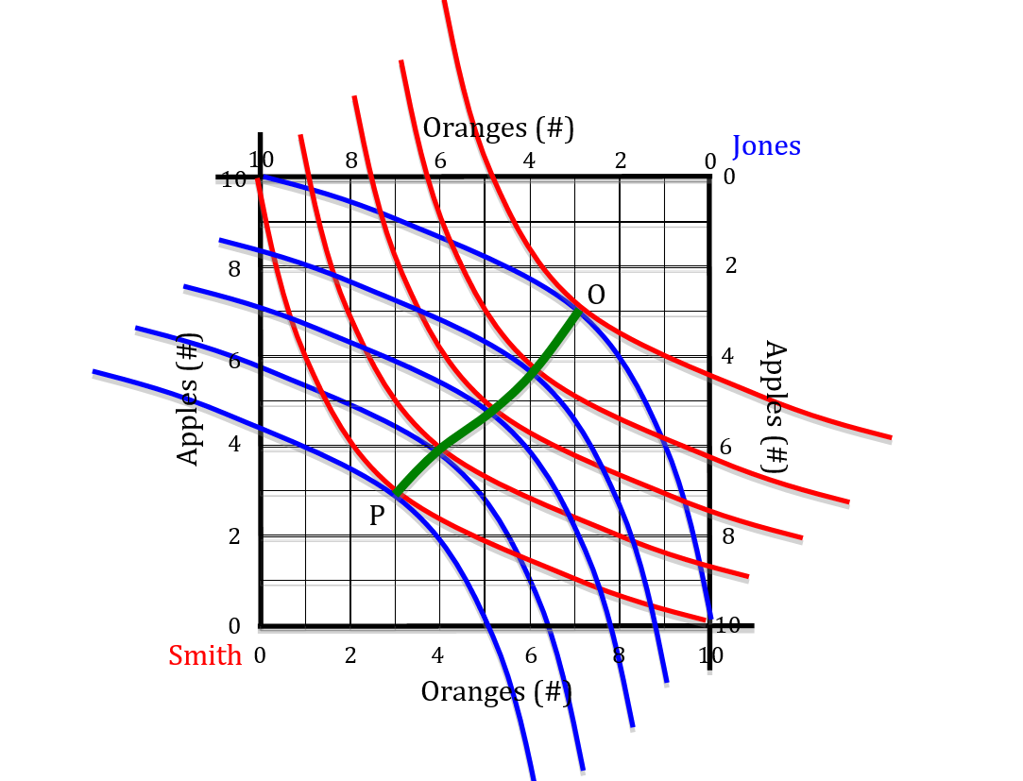

Slide 25
Pareto Optimalty and Economic Efficiency
If trade achieves a pareto optimal outcome, economists say the outcome is economically efficient.
Thus, economic efficiency means that there is no way to further increase the well-being of the traders.
In the pure exchange model, there is no increase in overall goods available, thus, the mutual increase in utility arises solely due to a reallocation of consumption … this is called consumption efficiency
An allocation can be very unequal and still economically efficient.

Slide 27
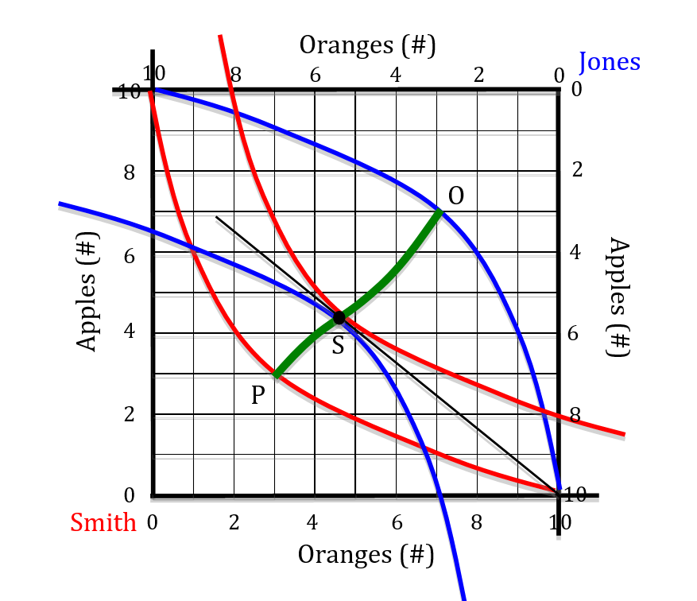

Slide 28
Pure Exchange Model Implications
If Smith and Jones are merely utility seeking
Then they will trade to some point in the lens of the EB
and both will become better-off from trade.
If Smith and Jones are rational and Utility maximizing
Then they will trade to a pareto optimal point that satisfies the utility maximizing condition
And both will become better-off

